Slide 1
CUSTOMER RELATIONSHIP MANAGEMENT(CRM)

Slide 2
CLIENT INFORMATION
Client : TRENT
Trent Limited is an Indian retail company, which is part of Tata Group and based out of Mumbai. Started in 1998, Trent operates Westside, Landmark a retail fashion chain, a bookstore chain in various locations of India.

Slide 3
Project business need
Saves Time and Money by Reducing Manual Efforts. ...
Streamline Business's Sales Process. ...
Centralization of Customer Information. ...
Improves Customer Services. ...
Detail Analytics of the Sales Process. ...
To Automate Business Process. ...
Manage Contacts with Ease. ...

Slide 4
Project Architecture
TRENT
Campaign
Lead
Organization
Opportunities
Contacts
Products
Vendor
Pricebook
Quotation
Sales order
Invoice

Slide 5
Project Architecture
Vendor
Products
Pricebook
Lead
Campaign
Opportunities
Contacts
Quotation
Sales Order
Organization
Invoice

Slide 6
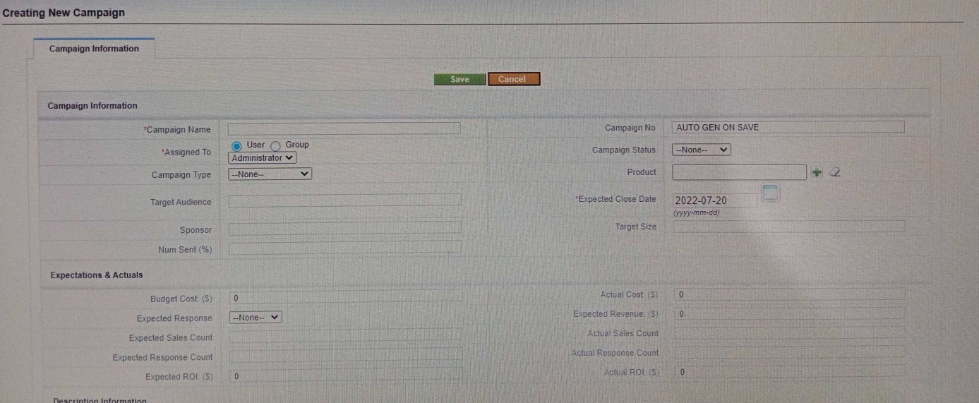
Project module explanation
Campaign
The Campaign module in CRM helps you plan and monitor marketing campaigns in your business. Any promotional campaign, be it online or offline - such as Google Ads, Trade shows, PR events, TV Commercials, Referral program - requires to be meticulously planned and executed in order to be effective.
This is where the Campaigns module enters into picture - it helps you track a Campaign by recording details such as Budget, Actual Cost, Expected Revenue from the campaign, the duration and so on

Slide 7
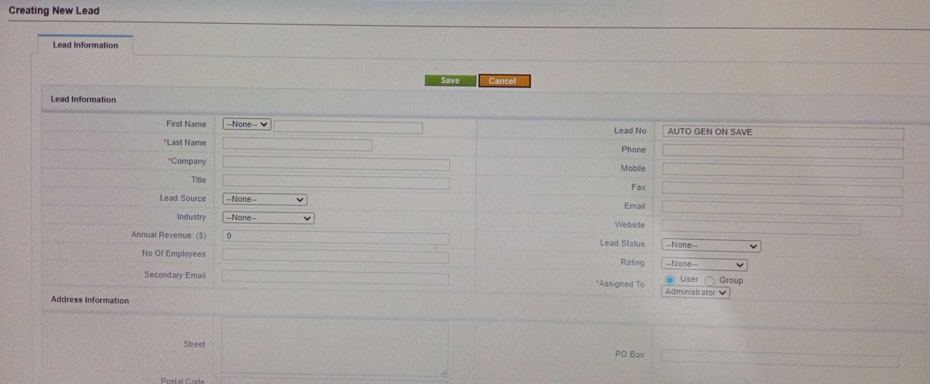
Project module explanation
2. Lead
A lead in business, also called as sales lead, is a consumer who is interested in what company has offer.
Both sales people and marketers strive to convert people who are interested in their products and services into customer.
After creating campaign, we are going to create Lead.
The module comprises details of the people who have shown interest in our company’s product

Slide 8
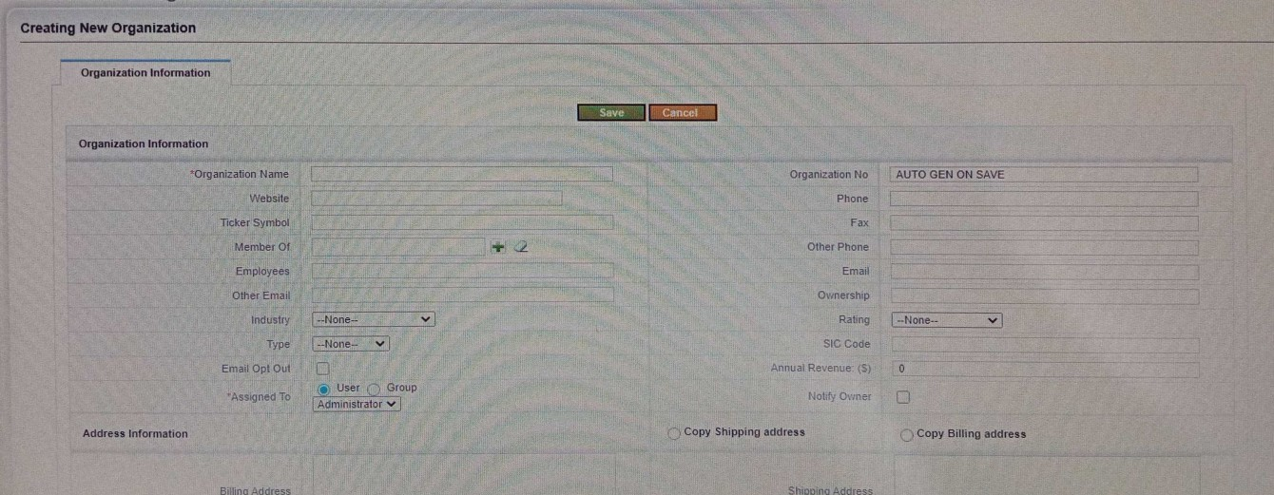
Project module explanation
3. Organization
An organization represents a company or an institution that has multiple employees associated with it.
If the deal is won, the organization will become a customer.
If not, we can still retain a repository of information about the organization should we be doing business with them in future.

Slide 9
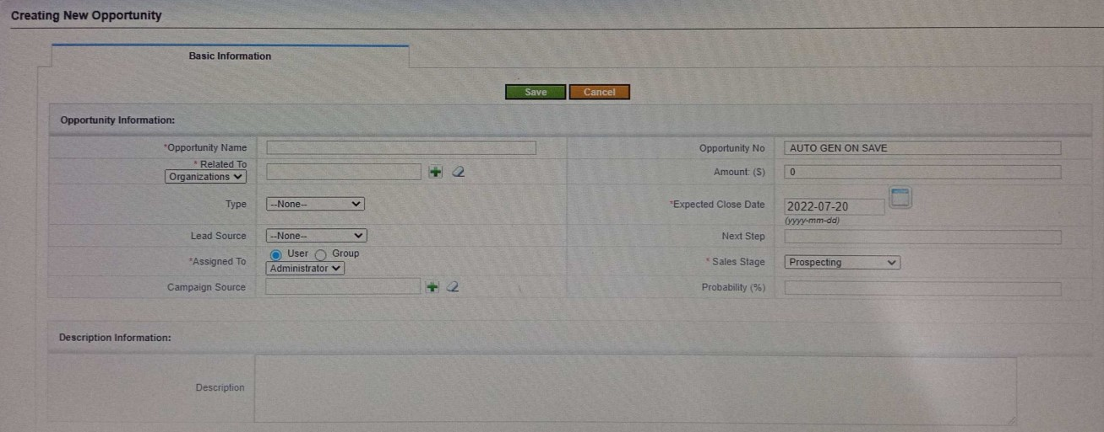
Project module explanation
4. Opportunities
When we are sure that our customer will 100% purchase the product, he becomes our opportunity.
This gets us into a new module called as Opportunities.

Slide 10
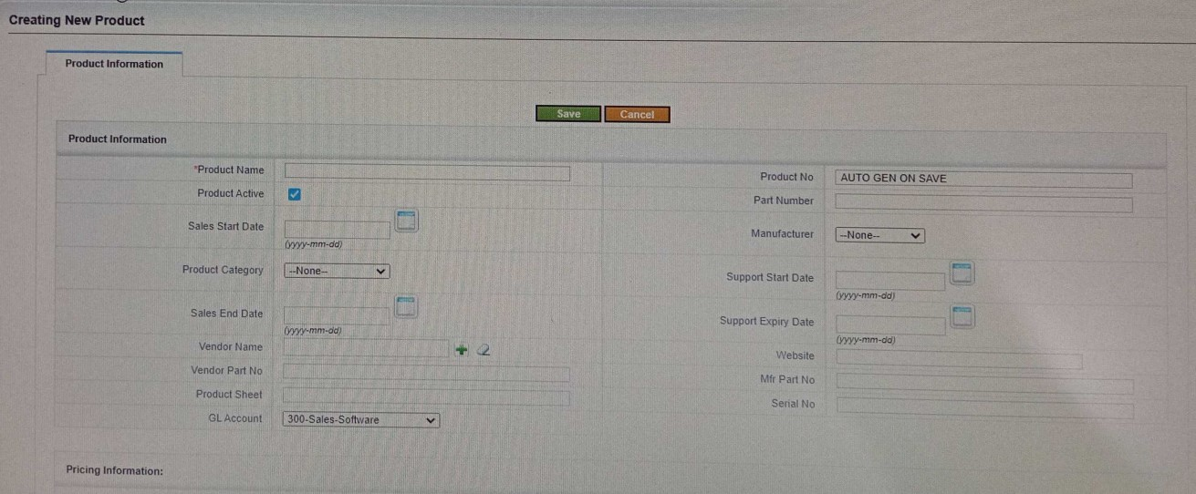
Project Module Explanation
5. Products
A Product is the item offered for sale. A product can be service or an item present in physical or virtual form.
This module deals with the details of the product our client is going to purchase.

Slide 11
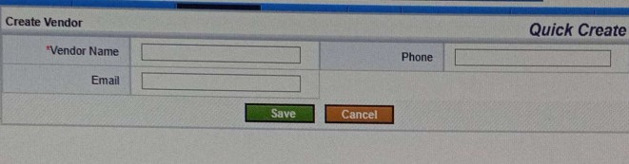
Project module explanation
6. Vendor
Vendors include companies, people, and contractors from which one’s company gets product and services.
They can be either direct manufacturers or resellers

Slide 12
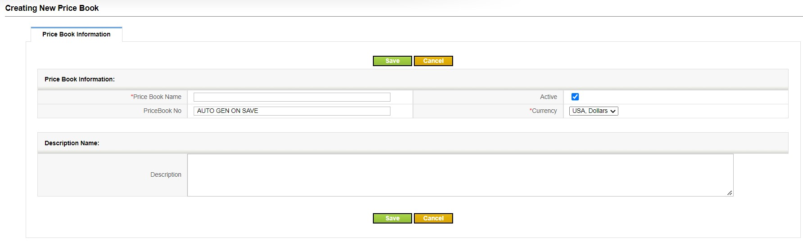
Project module explanation
7. Price Book
A Price Book contains predefined list of items that can be added to invoices .
Each Price Book can have up to many items.
Once we are done with the products module we will go to price book module
We will need to create one price book for all products.

Slide 13
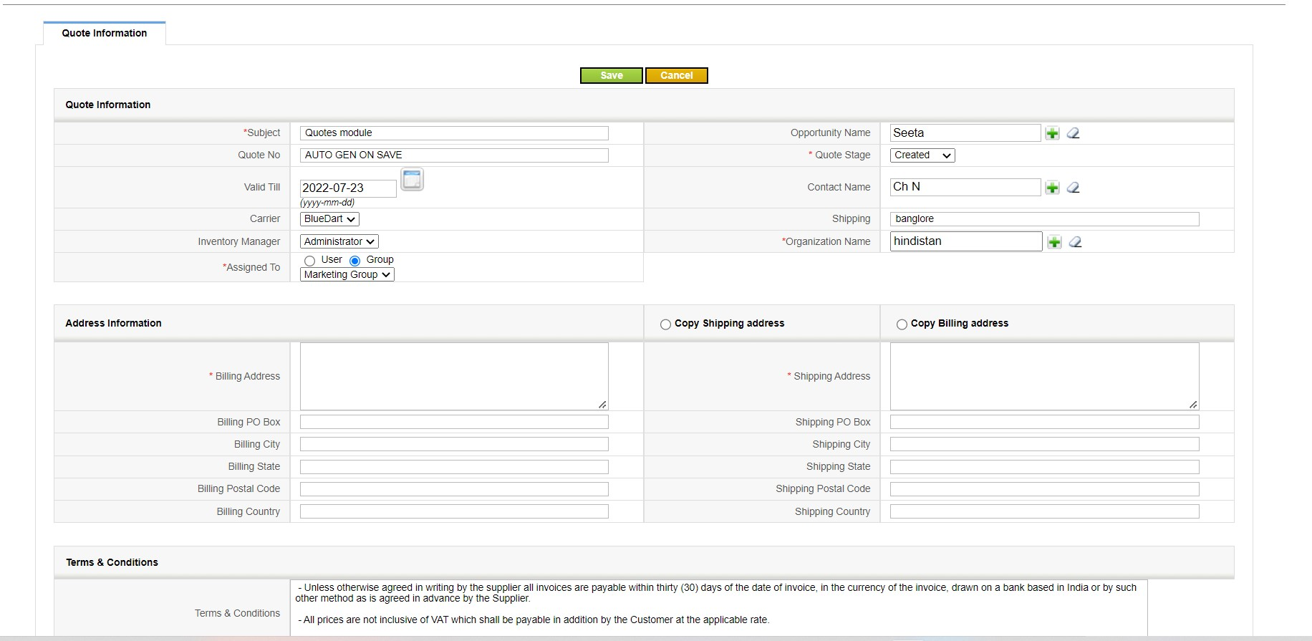
8. Quotes
It is a document that lists the prices proposed by a seller for their goods or services and offered to a potential customer.
A quote is the last price at which an asset is traded, it is the most recent price that a buyer and seller agrees upon and at which some amount of the asset is transacted.

Slide 14
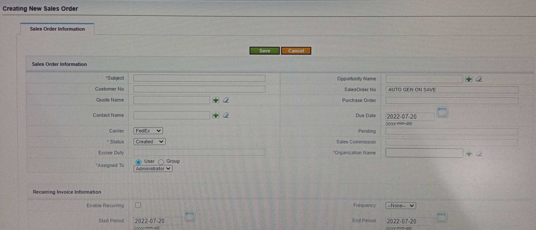
Project module explanation
9. Sales Order
A sale order usually carries information such as opportunity name, sales order no, due date, carrier, organization name, etc.

Slide 15
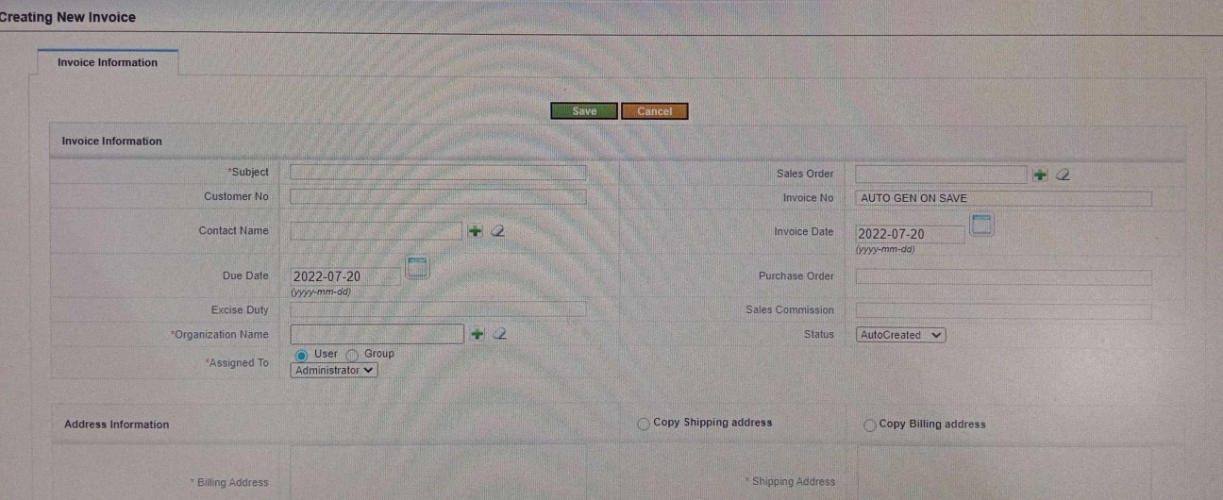
Project module explanation
10. Invoice
An Invoice is a document issued by a seller or buyer, to specify the payment details of a good or services
Invoices are useful because they serve as a record of sale as well as legal proof an agreement.

Slide 16
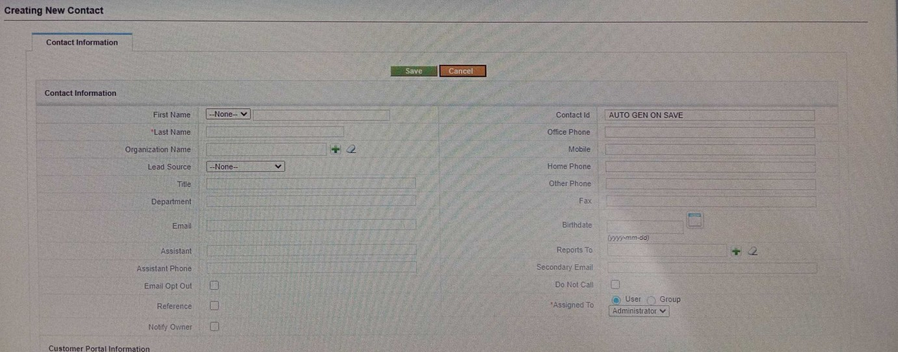
11. Contacts
The term contact is an individual who has purchased your product or a service or a company representative responsible for purchasing.

Slide 17
Functional Dependencies
Organisation
Contacts
Organisation
Opportunities
Campaign

Slide 18
Functional Dependencies
Vendor
Opportunities
Products
Organisation
Quotation
Contacts
Opportunities
Organisation
Invoice
Sales Order
Contacts
Organisation
Contacts

Slide 19
Project business few workflow
1. Login to Vtiger, Click on lead major tab, click on add icon and enter all the details, click on save button lead is created click on leads major tab click on edit link under actions edit the details and click on save.
2. Login to Vtiger, click on opportunities major tab, click on add button, enter all the details and click on save.
3. Login to Vtiger, click on more dropdown click on vendors link, vendors page will be displayed. Click on add icon enter all the details and click on save button, click on delete link under actions click on ok vender will be deleted
4. Login to Vtiger, click on products major tab click on add icon enter all the details click on save button product should be added.

Slide 20
Effort & estimation
us_id | us_name | task | Test case | Story point | mph | days
us_01 | Campaigns | t-01 | +-25 | 2 | 16 | 2days
us_02 | Lead module | t-02 (create lead) t-03 (edit lead) | +-20 +-10 | 1 1 | 8 8 | 1day 1day
us_03 | Organization | t-04 | +-25 | 2 | 16 | 2days
us_04 | Opportunities | t-05 | +-25 | 2 | 16 | 2days
us_05 | Products | t-06 | +-20 | 2 | 16 | 2days
us_06 | Quotes | t-07 | +-35 | 2 | 16 | 2days
 |  |  | 160 | 12 | 96 | 12

